Slide 1


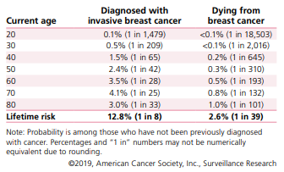
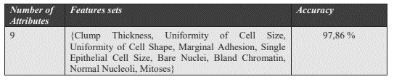

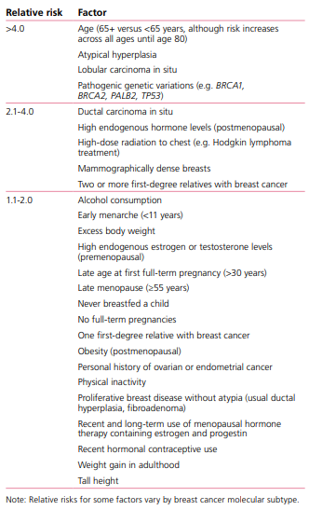


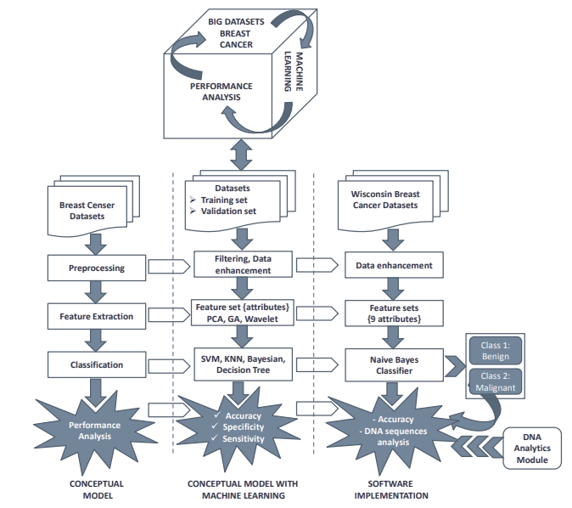


Breast cancer detection applying machine learning
Trish Girmus
Bellevue University
tgirmus@my365.bellevue.edu
INTRODUCTION
FIGURE 2 – Probability of Breast Cancer Diagnosis or Death for US Women Based on Age
DELIVERABLE
FIGURE 8 – NAÏVE BAYES Classifier Performance Results
Breast cancer is the most common diagnosed cancer in women. It is also the second cause of cancer death with lung cancer being the first. Men are also susceptible to this disease, but the odds are fewer. An estimated 41,760 women will die this year from breast cancer as well as 500 men. When breast cancer is detected early at a localized stage, the five-year survival rate is 99%. Early detection and an accurate diagnosis are vital to increase survival rates. Mammogram screening is the primary technology for diagnosis and human error can result as doctors make these observations/diagnoses themselves. Machine learning classifiers can help doctors make accurate diagnoses quickly and affordably, thus an option to help prolong lives. The goal of this project is to identify how machine learning techniques can be applied to detect breast cancer and highlight several algorithms that might be best suited based on research.
Machine learning (ML) is gaining momentum in the medical profession as it can help with predicting cancer susceptibility, survival rates and treatments. It creates and trains models which can be used for classification or prediction purposes. Machine learning could help with identifying and predicting cancer. The supervised classification model can determine whether a tumor is malignant or benign.
FIGURE 5 – Breast Cancer Image Classification Model
In the study using this classification model five non-linear machine learning algorithms were used: Multilayer perceptron (MLP), K-Nearest Neighbors (KNN), Classification and Regression Trees (CART), Naïve Bayes (NB) and Support Vector Machines (SVM). The steps for this model were to measure the classification test accuracy, recall and precision. Using the Wisconsin Breast Cancer Diagnostic (WBCD) dataset, the study concluded the MLP classifier had the highest accuracy to classify a tumor as benign or malignant.
FIGURE 7 - Conceptual Model for Early Detection of Breast Cancer
https://aip.scitation.org/doi/pdf/10.1063/1.5014010
Steps for the conceptual model, steps include pre-processing, feature extraction, classification, and performance analysis. As in Figure 5, this model the classification step is important as it classifies whether the data is benign or malignant. Classifiers such as Support Vector Machines (SVM), K-Nearest Neighbors (KNN), Naïve Bayes, and Decision Tree are examples of algorithms for this type of study.
https://aip.scitation.org/doi/pdf/10.1063/1.5014010
The Naïve Bayes classifier was used for this study and as Figure 8 shows, the accuracy was 97.86%
https://www.cancer.org/content/dam/cancer-org/research/cancer-facts-and-statistics/breast-cancer-facts-and-figures/breast-cancer-facts-and-figures-2019-2020.pdf
WHY IS THIS DATA SCIENCE?
Machine learning and data science are providing efficiency, accuracy and giving professionals in the medical field a second opinion on the diagnosis of breast cancer disease. The use of machine learning algorithms can help identify, classify, and predict outcomes effectively. With the increase in breast cancer over the years, more data has been compiled which can be used for partnering together data science and medicine for further study and research.
FIGURE 3 – Increased Risk Ractors for Invasive Breast Cancer in Women
http://www.ijmlc.org/vol9/794-L0201.pdf
FIGURE 1 – Comparison of Women vs. Men in Development of Breast Cancer
CONCLUSIONS
One in Eight Women Will Develop Breast Cancer in Her Lifetime
Breast cancer is a horrible disease and claimed the lives of many women as well as men. It is commonly detected by a doctor through a medical examination. Unfortunately, the human eye and other factors can cause a misdiagnosis. Early detection is vital to save lives as well as to increase survival rates of those who have been diagnosed with breast cancer. By utilizing machine learning and applying classification algorithms, doctors and other medical professionals can accurately diagnose this disease. This poster highlighted several different methods and common supervised learning models, showing the reliability and accuracy with prediction techniques.
FIGURE 6 – Accuracy Scores Using Five Classifiers
http://www.ijmlc.org/vol9/794-L0201.pdf
ACKNOWLEDGMENTS
I’d like to take a moment to acknowledge anyone who is currently diagnosed with cancer or had a loved one who lost the battle to this disease. My thoughts are with you. We will win this fight.
A sincere appreciation and thank you to my friends and family for their encouragement and support. I would also like to thank Professor Singh and the wonderful faculty at Bellevue University for the opportunity to make a difference in this world.
Men Can Also Be Diagnosed with Breast Cancer But Less Likely Than Women
https://www.cancer.org/content/dam/cancer-org/research/cancer-facts-and-statistics/breast-cancer-facts-and-figures/breast-cancer-facts-and-figures-2019-2020.pdf
1 in 1,000 Men Will Develop Breast Cancer in His Lifetime
FIGURE 4 – Process of Diagnostic
Source of the data of breast cancer
Pre-processing of data
Features selection
https://www.nationalbreastcancer.org/breast-cancer-facts
Classification
https://www.semanticscholar.org/paper/Proposed-approach-for-breast-cancer-diagnosis-using-Saoud-Ghadi/6fec944321a94b13f6671e6cc23d6fabc7ba58c3/figure/3

